Slide 1
Clean Code
Agile Software Craftsmanship
-- Fu, Biye

Slide 2
Contents
Clean code
Test
Principles and Patterns
Lines and blocks
High level
Smells and Heuristics

Slide 3
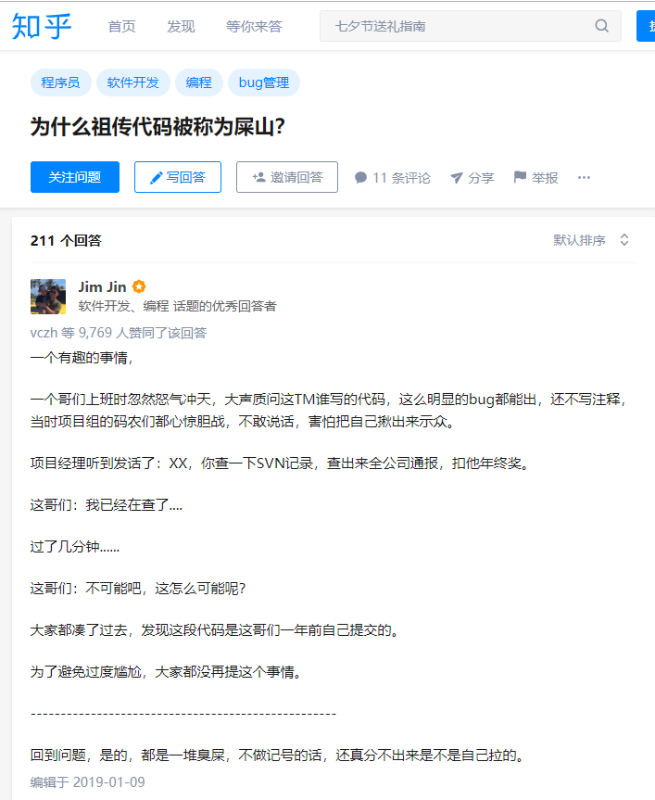
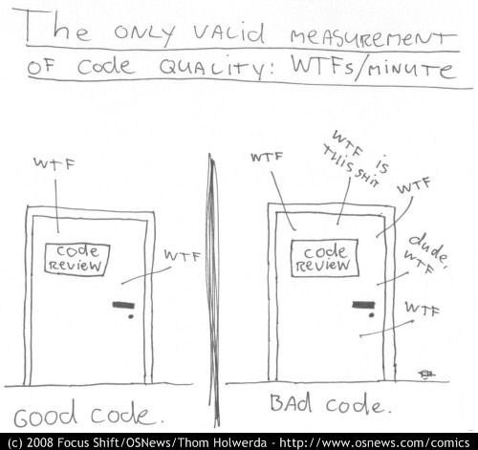
Clean Code
Views of tech expert:
Elegant，Efficient
Readability
Easy for other people to enhance it
Test
No duplication
Do one thing
Expressiveness
Tiny abstractions
The Boy Scout Rule
Leave the campground cleaner than you found it.

Slide 4
Meaningful Names
Use Intention-Revealing Names int d => int elapsedTimeInDays
Make Meaningful Distinctions
Number-series: public static void copyChars(char a1[], char a2[]) => (source, destination)
Noise words: ProductInfo and ProductData , Info and Data => indistinct noise words
Use Pronounceable Name genymdhms => generationTimestamp
Use Searchable Names single-letter names, numeric constants
Avoid Encodings
Hungarian Notation(匈牙利命名法): wParam
Member Prefixes: m_dsc
Interfaces and implementations: IShapeFactory => ShapeFactory
Class Name should have noun or noun phrase, Method Names should have verb or verb phrase
Don’t Be Cute: 说人话
Pick One Word pre Concept: fetch, retrieve, get AND Don’t Pun avoid using the same word for two purposes
Use Solution Domain Names: algorithm names, pattern names, math terms
Add meaningful context: state => addrState

Slide 5
Functions
Small < 100 lines (~ 20 lines)
Do One Thing: FUNCTIONS SHOULD DO ONE THING. THEY SHOULD DO IT WELL. THEY SHOULD DO IT ONLY
One Level of Abstraction per Function
Reading Code from Top to Bottom: The Stepdown Rule
Switch Statements => AbstractFactory
Arguments
Number: 0 > 1 > 2 > 3
Avoids: Output Argument, Flag Arguments
Using: Argument Objects, Argument List, Verbs and Keywords
Have No Side Effects
Command Query Separation
Prefer Exceptions to Returning Error Codes
Extract Try/Catch Blocks
Error handling Is One Thing
Don’t Repeat Yourself

Slide 6
Formatting
Vertical Formatting
The Newspaper Metaphor
High level concept and algorithms at top most
Details should increase as we move downward
Vertical Distance: Concepts that are closely related should be kept vertically close to each other
Variable Declarations: Should be declared as close to their usage as possible
Instance variable: should be declared at the top of class. In a well-designed class , they are used by many
Dependent functions: vertically close, caller should be above callee
Horizontal Formatting
Horizontal Alignment: no alignment if a long list need to be aligned, the problem is the length of the lists.
DON’T FORMAT WHOLE FILE!!!
ONLY FORMAT MODIFIED PART!!!

Slide 7
Objects and Data Structures
Data Abstraction Hiding implementation
Data/Object Anti-Symmetry
Objects: hide their data and expose functions
Data structure: expose their data and no meaningful functions
The Law of Demeter
A module should not know about the innards of the objects
Train Wrecks a.xxx().yyy().zzz() -> X x = a.xxx(); Y y = x.yyy(); Z z = y.zzz();
Hybrids should be avoided when creating
Hiding Structure Z z = a.doSometing()
an object we should be telling it to do something; we should not be asking it about its internals
Data Transfer Objects
DTO communicating with DB or parsing messages from sockets
“bean” form, have private variables manipulate by getters and setters

Slide 8
Error Handling
Use Exceptions Rather Than Return Codes
Write Your Try-Catch-Finally Statement First
Use Unchecked Exceptions: checked exception is an Open/Closed Principle violation
Provide Context with Exceptions: source, location and informative error messasge
Define Exception Classes in Terms of a Caller’s Needs
Define the Normal Flow SPECIAL CASE PATTERN
Don’t Return Null throws an exception or returns a special case object
Don’t Pass Null

Slide 9
Boundaries
Using Third-Party Code
Not to pass any interface at a boundary around your system, keep it inside the class(e.g. using Map)
Exploring and Learning Boundaries
write learning tests
Learning Tests Are Better Than Free
We had to learn the API
verify new releases behavior difference
Using Code That Does Not Yet Exist
made us aware of what we wanted
then using Adapter to implement

Slide 10
Unit Tests
The Three Laws of TDD
1. You may not write production code until you have written a failing unit test
2. You may not write more of a unit test than is sufficient to fail, and not compiliing is failing.
3. You may not write more production code than is sufficient to pass the currently failing test.
Keeping Test Clean
It is unit tests that keep our code flexible, maintainable, and reusable
Clean Tests
Core: Readablility, BULID-OPERATE-CHECK pattern
Domain-Specific Testing Language
A Dual Standard: could be worse than production code.

